Slide 1
Deadlocks

Slide 2
Deadlocks
System Model
Deadlock Characterization
Methods for Handling Deadlocks
Deadlock Prevention
Deadlock Avoidance
Deadlock Detection
Recovery from Deadlock

Slide 3
Objectives
To develop a description of deadlocks, which prevent sets of concurrent processes from completing their tasks
To present a number of different methods for preventing or avoiding deadlocks in a computer system

Slide 4
System Model
In a multiprogramming environment, several processes may compete for a finite number of resources.
A process requests resources; if the resources are not available at that time, the process enters a waiting state.
Sometimes, a waiting process is never again able to change state, because the resources it has requested are held by other waiting processes.
This situation is called a deadlock.

Slide 5
System Model
System consists of resources
Resource types R₁, R₂, . . ., R_{m}
    CPU cycles, memory space, I/O devices
Each resource type R_{i} has W_{i} instances.
Each process utilizes a resource as follows:
Request. The process requests the resource.
If the request cannot be granted immediately then the requesting process must wait until it can acquire the resource.
2. Use. The process can operate on the resource (for example, if the resource is a printer, the process can print on the printer).
3. Release. The process releases the resource.

Slide 6
Deadlock Characterization
Deadlock can arise if four conditions hold simultaneously.
Mutual exclusion: only one process at a time can use a resource
Hold and wait: a process holding at least one resource is waiting to acquire additional resources held by other processes
No preemption: a resource can be released only voluntarily by the process holding it, after that process has completed its task
Circular wait: there exists a set {P₀, P₁, …, P_{n}} of waiting processes such that P₀ is waiting for a resource that is held by P₁, P₁ is waiting for a resource that is held by P₂, …, P_{n–1} is waiting for a resource that is held by P_{n}, and P_{n} is waiting for a resource that is held by P₀.

Slide 7
Resource-Allocation Graph
A set of vertices V and a set of edges E.
V is partitioned into two types:
  P = {P₁, P₂, …, P_{n}}, the set consisting of all the processes in the system
  R = {R₁, R₂, …, R_{m}}, the set consisting of all resource types in the system
request edge – directed edge P_{i} → R_{j}
assignment edge – directed edge R_{j} → P_{i}

Slide 8



Resource-Allocation Graph (Cont.)
Process
Resource Type with 4 instances
P_{i} requests instance of R_{j}
P_{i} is holding an instance of R_{j}
P_{i}
R_{j}
P_{i}
R_{j}

Slide 9
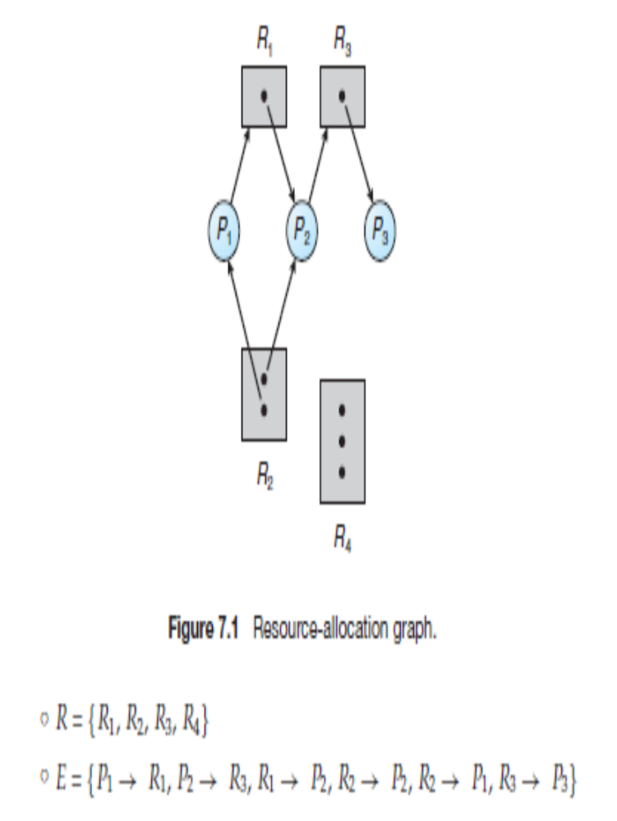
Example of a Resource Allocation Graph
◦ R = {R1, R2, R3, R4}
◦ E = {P1 → R1, P2 → R3, R1 → P2, R2 → P2, R2 → P1, R3 → P3}
• Resource instances:
◦ One instance of resource type R1
◦ Two instances of resource type R2
◦ One instance of resource type R3
◦ Three instances of resource type R4
• Process states:
◦ Process P1 is holding an instance of resource type R2 and is waiting for an instance of resource type R1.
◦ Process P2 is holding an instance of R1 and an instance of R2 and is waiting for an instance of R3.
◦ Process P3 is holding an instance of R3.

Slide 10
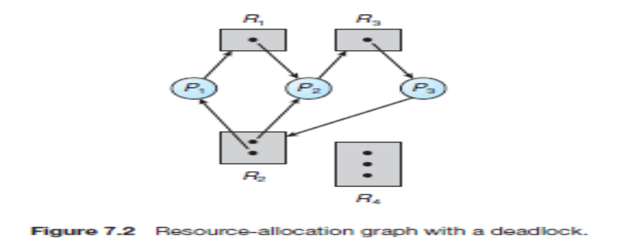
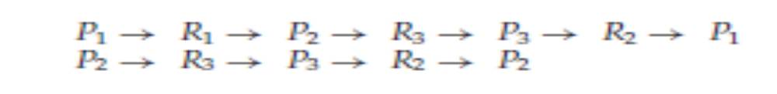
Resource Allocation Graph With A cycle with Deadlock
However, there is no deadlock. Observe that process P4 may release its instance
of resource type R2.
That resource can then be allocated to P3, breaking the cycle.

Slide 11
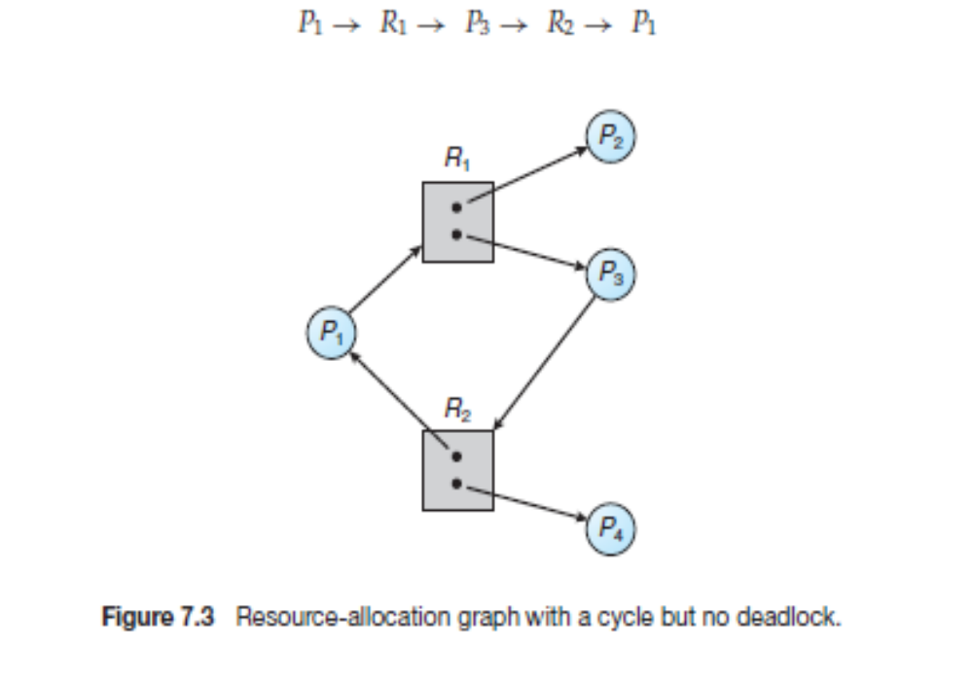
Resource Allocation Graph With A cycle but no deadlockDeadlock

Slide 12
Basic Facts
If graph contains no cycles ⇒ no deadlock
If graph contains a cycle ⇒
  if only one instance per resource type, then deadlock
  if several instances per resource type, possibility of deadlock

Slide 13
Methods for Handling Deadlocks
Generally speaking, we can deal with the deadlock problem in one of three ways:
• We can use a protocol to prevent or avoid deadlocks, ensuring that the system will never enter a deadlocked state.
• We can allow the system to enter a deadlocked state, detect it, and recover.
We can ignore the problem altogether and pretend that deadlocks never occur in the system.

Slide 14
Methods for Handling Deadlocks
To ensure that deadlocks never occur, the system can use either a deadlock prevention or a deadlock-avoidance scheme.
Deadlock prevention provides a set of methods to ensure that at least one of the necessary conditions) cannot hold. These methods prevent deadlocks by constraining how requests for resources can be made.
Deadlock avoidance the operating
system can decide for each request whether or not the process should wait.
To decide whether the current request can be satisfied or must be delayed, the system must consider the resources currently available, the resources currently allocated to each process, and the future requests and releases of each process.

Slide 15
Methods for Handling Deadlocks
The mutual exclusion condition must hold for non-sharable resources.
That is, several processes cannot simultaneously share a single resource.
This condition is difficult to eliminate because some resources, such as the tap drive and printer, are inherently non-shareable.
Note that shareable resources like read-only-file do not require mutually exclusive access and thus cannot be involved in deadlock.

Slide 16
Deadlock Prevention- Mutual Exclusion
Restrain the ways request can be made
The mutual exclusion condition must hold.
That is, at least one resource must but non-sharable.
Sharable resources, in contrast, do not require mutually exclusive access and thus cannot be involved in a deadlock.
Read-only files are a good example of a sharable resource. If several processes attempt to open a read-only file at the same time, they can be granted simultaneous access to the file.
A process never needs to wait for a sharable resource.
In general, however, we cannot prevent deadlocks by denying the mutual-exclusion condition, because some resources are intrinsically non-sharable.
For example, a mutex lock cannot be simultaneously shared by several processes.

Slide 17
Deadlock Prevention- Hold and Wait
To ensure that the hold-and-wait condition never occurs in the system, we must guarantee that, whenever a process requests a resource, it does not hold any other resources.
One protocol that we can use requires each process to request and be allocated all its resources before it begins execution.
We can implement this provision by requiring that system calls requesting resources for a process precede all other system calls.

Slide 18
Deadlock Prevention (Cont.)
No Preemption –
The third necessary condition for deadlocks is that there be no preemption of resources that have already been allocated.
To ensure that this condition does not hold, we can use the following protocol.
If a process is holding some resources and requests another resource that cannot be immediately allocated to it (that is, the process must wait), then all resources the process is currently holding are preempted.
In other words, these resources are implicitly released.
The preempted resources are added to the list of resources for which the process is waiting.
The process will be restarted only when it can regain its old resources, as well as the new ones that it is requesting.

Slide 19
Circular Wait
Circular Wait – impose a total ordering of all resource types, and require that each process requests resources in an increasing order of enumeration
The fourth and final condition for deadlocks is the circular-wait condition.
One way to ensure that this condition never holds is to impose a total ordering of all resource types and to require that each process requests resources in an increasing order of enumeration.
To illustrate, we let R = {R1, R2, ..., Rm} be the set of resource types.
We assign to each resource type a unique integer number, which allows us to compare two resources and to determine whether one precedes another in our ordering.

Slide 20
Deadlock Prevention (Cont.)
Circular Wait – impose a total ordering of all resource types, and require that each process requests resources in an increasing order of enumeration
The last condition, the circular wait, can be denied by imposing a total ordering on all of the resource types and than forcing, all processes to request the resources in order (increasing or decreasing). This strategy impose a total ordering of all resources types, and to require that each process requests resources in a numerical order (increasing or decreasing) of enumeration. With this rule, the resource allocation graph can never have a cycle.
For example, provide a global numbering of all the resources, as shown
  1 ≡ Card reader
  2 ≡ Printer
  3 ≡ Plotter
  4 ≡ Tape drive
  5 ≡ Card punch
  Now the rule is this: processes can request resources whenever they want to, but all requests must be made in numerical order. A process may request first printer and then a tape drive (order: 2, 4), but it may not request first a plotter and then a printer (order: 3, 2). The problem with this strategy is that it may be impossible to find an ordering that satisfies everyone.

Slide 21
Deadlock Avoidance
Requires that the system has some additional a priori information available
Simplest and most useful model requires that each process declare the maximum number of resources of each type that it may need
The deadlock-avoidance algorithm dynamically examines the resource-allocation state to ensure that there can never be a circular-wait condition
Resource-allocation state is defined by the number of available and allocated resources, and the maximum demands of the processes

Slide 22
Safe State
A state is safe if the system can allocate resources to each process (up to its maximum) in some order and still avoid a deadlock.
More formally, a system is in a safe state only if there exists a safe sequence.
A sequence of processes <P1, P2, ..., Pn> is a safe sequence for the current allocation state if, for each Pi, the resource requests that Pi can still make can be satisfied by the currently available resources plus the resources held by all Pj, with j <i.
In this situation, if the resources that Pi needs are not immediately available, then Pi can wait until all Pj have finished.
When they have finished, Pi can obtain all of its needed resources, complete its designated task, return its allocated resources, and terminate.
When Pi terminates, Pi+1 can obtain its needed resources, and so on. If no such sequence exists, then the system state is said to be unsafe.

Slide 23
Basic Facts
If a system is in safe state ⇒ no deadlocks
If a system is in unsafe state ⇒ possibility of deadlock
Avoidance ⇒ ensure that a system will never enter an unsafe state.

Slide 24

Safe, Unsafe, Deadlock State

Slide 25
Avoidance Algorithms
Single instance of a resource type
  Use a resource-allocation graph
Multiple instances of a resource type
  Use the banker’s algorithm

Slide 26
Resource-Allocation Graph Scheme
In addition to the request and assignment edges already described, we introduce a new type of edge, called a claim edge.
A claim edge Pi → Rj indicates that process Pi may request resource Rj at some time in the future.
This edge resembles a request edge in direction but is represented in the graph by a dashed line. When process Pi requests resource
Rj, the claim edge Pi → Rj is converted to a request edge. Similarly, when a resource Rj is released by Pi, the assignment edge Rj → Pi is reconverted to a claim edge Pi → Rj .

Slide 27

Resource-Allocation Graph

Slide 28

Unsafe State In Resource-Allocation Graph

Slide 29
Resource-Allocation Graph Algorithm
Suppose that process P_{i} requests a resource R_{j}
The request can be granted only if converting the request edge to an assignment edge does not result in the formation of a cycle in the resource allocation graph.

Slide 30
Banker’s Algorithm
Multiple instances
Each process must a priori claim maximum use
When a process requests a resource it may have to wait
When a process gets all its resources it must return them in a finite amount of time

Slide 31
Data Structures for the Banker’s Algorithm
Let n = number of processes, and m = number of resources types.
Available: Vector of length m. If available [j] = k, there are k instances of resource type R_{j} available
Max: n x m matrix. If Max [i,j] = k, then process P_{i} may request at most k instances of resource type R_{j}
Allocation: n x m matrix. If Allocation[i,j] = k then P_{i} is currently allocated k instances of R_{j}
Need: n x m matrix. If Need[i,j] = k, then P_{i} may need k more instances of R_{j} to complete its task
    Need [i,j] = Max[i,j] – Allocation [i,j]

Slide 32
Safety Algorithm
1. Let Work and Finish be vectors of length m and n, respectively. Initialize:
      Work = Available
      Finish [i] = false for i = 0, 1, …, n- 1
2. Find an i such that both:
  (a) Finish [i] = false
  (b) Need_{i} ≤ Work
  If no such i exists, go to step 4
3. Work = Work + Allocation_{i}
Finish[i] = true
go to step 2
4. If Finish [i] == true for all i, then the system is in a safe state

Slide 33
Resource-Request Algorithm for Process P_{i}
Request_{i} = request vector for process P_{i}. If Request_{i} [j] = k then process P_{i} wants k instances of resource type R_{j}
  1. If Request_{i} ≤ Need_{i} go to step 2. Otherwise, raise error condition, since process has exceeded its maximum claim
  2. If Request_{i} ≤ Available, go to step 3. Otherwise P_{i} must wait, since resources are not available
  3. Pretend to allocate requested resources to P_{i} by modifying the state as follows:
      Available = Available – Request_{i};
      Allocation_{i} = Allocation_{i} + Request_{i};
      Need_{i} = Need_{i} – Request_{i};
    If safe ⇒ the resources are allocated to P_{i}
    If unsafe ⇒ P_{i} must wait, and the old resource-allocation state is restored

Slide 34
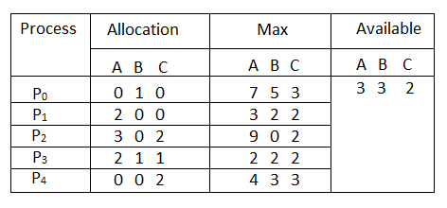
Example of Banker’s Algorithm
5 processes P₀ through P₄;
3 resource types:
A (10 instances), B (5instances), and C (7 instances)
Snapshot at time T₀:

Slide 35
Example (Cont.)
The content of the matrix Need is defined to be Max – Allocation
Need
A B C
P₀ 7 4 3
P₁ 1 2 2
P₂ 6 0 0
P₃ 0 1 1
P₄ 4 3 1
The system is in a safe state since the sequence < P₁, P₃, P₄, P₂, P₀> satisfies safety criteria

Slide 36
Example: P₁ Request (1,0,2)
Check that Request ≤ Available (that is, (1,0,2) ≤ (3,3,2) ⇒ true
Allocation Need Available
A B C A B C A B C
P₀ 0 1 0 7 4 3 2 3 0
P₁ 3 0 2 0 2 0
P₂ 3 0 2 6 0 0
P₃ 2 1 1 0 1 1
P₄ 0 0 2 4 3 1
Executing safety algorithm shows that sequence < P₁, P₃, P₄, P₀, P₂> satisfies safety requirement
Can request for (3,3,0) by P₄ be granted?
Can request for (0,2,0) by P₀ be granted?

Slide 37
Deadlock Detection
Allow system to enter deadlock state
Detection algorithm
Recovery scheme

Slide 38
Single Instance of Each Resource Type
Maintain wait-for graph
  Nodes are processes
  P_{i} → P_{j} if P_{i} is waiting for P_{j}
Periodically invoke an algorithm that searches for a cycle in the graph.
If there is a cycle, there exists a deadlock

Slide 39

Resource-Allocation Graph and Wait-for Graph
Resource-Allocation Graph
Corresponding wait-for graph

Slide 40
Several Instances of a Resource Type
Available: A vector of length m indicates the number of available resources of each type
Allocation: An n x m matrix defines the number of resources of each type currently allocated to each process
Request: An n x m matrix indicates the current request of each process.
If Request [i][j] = k, then process P_{i} is requesting k more instances of resource type R_{j}.

Slide 41
Detection Algorithm
1. Let Work and Finish be vectors of length m and n, respectively. Initialize Work = Available. For i = 0, 1, ..., n–1, if Allocation i ̸= 0, then Finish[i] = false. Otherwise, Finish[i] = true.
2. Find an index i such that both
a. Finish[i] == false
b. Requesti ≤ Work If no such i exists, go to step 4.
3. Work = Work + Allocationi
Finish[i] = true Go to step 2.
4. If Finish[i] ==false for some i, 0≤i<n, then the system is in a deadlocked state.
Moreover, if Finish[i] == false, then process Pi is deadlocked.

Slide 42
Example of Detection Algorithm
Five processes P₀ through P₄; three resource types
A (7 instances), B (2 instances), and C (6 instances)
Snapshot at time T₀:
Allocation Request Available
A B C A B C A B C
P₀ 0 1 0 0 0 0 0 0 0
P₁ 2 0 0 2 0 2
P₂ 3 0 3 0 0 0
P₃ 2 1 1 1 0 0
P₄ 0 0 2 0 0 2
Sequence <P₀, P₂, P₃, P₁, P₄> will result in Finish[i] = true for all i

Slide 43
Example (Cont.)
P₂ requests an additional instance of type C
Request
A B C
P₀ 0 0 0
P₁ 2 0 2
P₂ 0 0 1
P₃ 1 0 0
P₄ 0 0 2
State of system?
  Can reclaim resources held by process P₀, but insufficient resources to fulfill other processes; requests
  Deadlock exists, consisting of processes P₁, P₂, P₃, and P₄

Slide 44
Detection-Algorithm Usage
When, and how often, to invoke depends on:
  How often a deadlock is likely to occur?
  How many processes will need to be rolled back?
If detection algorithm is invoked arbitrarily, there may be many cycles in the resource graph and so we would not be able to tell which of the many deadlocked processes “caused” the deadlock.

Slide 45
Recovery from Deadlock: Process Termination
Abort all deadlocked processes. This method clearly will break the
deadlock cycle, but at great expense. The deadlocked processes may have computed for a long time, and the results of these partial computations must be discarded and probably will have to be recomputed later.
• Abort one process at a time until the deadlock cycle is eliminated. This method incurs considerable overhead, since after each process is aborted, a deadlock-detection algorithm must be invoked to determine whether any processes are still deadlocked.

Slide 46
In which order should we choose to abort?
Unfortunately, the term minimum cost is not a precise one.
Many factors may affect which process is chosen, including:
1. What the priority of the process is
2. How long the process has computed and how much longer the process will compute before completing its designated task
3. How many and what types of resources the process has used (for example, whether the resources are simple to preempt)
4. How many more resources the process needs in order to complete
5. How many processes will need to be terminated
6. Whether the process is interactive or batch

Slide 47
Recovery from Deadlock: Resource Preemption
To eliminate deadlocks using resource preemption, we successively preempt some resources from processes and give these resources to other processes until the deadlock cycle is broken.
Selecting a victim – minimize cost
Rollback – return to some safe state, restart process for that state
Starvation – same process may always be picked as victim, include number of rollback in cost factor

Slide 48
Recovery from Deadlock: Resource Preemption
1. Selecting a victim. Which resources and which processes are to be preempted? As in process termination, we must determine the order of preemption to minimize cost.
Cost factors may include such parameters as the number of resources a deadlocked process is holding and the amount of time the process has thus far consumed.
2. Rollback. If we preempt a resource from a process, what should be done with that process? Clearly, it cannot continue with its normal execution; it is missing some needed resource. We must roll back the process to some safe state and restart it from that state.
Since, in general, it is difficult to determine what a safe state is, the simplest solution is a total rollback: abort the process and then restart it.
Although it is more effective to roll back the process only as far as necessary to break the deadlock, this method requires the system to keep more information about the state of all running processes.
3. Starvation. How do we ensure that starvation will not occur? That is, how can we guarantee that resources will not always be preempted from the same process?
In a system where victim selection is based primarily on cost factors, it may happen that the same process is always picked as a victim. As a result, this process never completes its designated task, a starvation situation any practical system must address.

